Slide 1
Software Process Models
based on slides of Sommerville and Pressman

Slide 2
What is a Process?
(Webster) A system of operations in producing something; a series of actions, changes, or functions that achieve an end or a result
(IEEE) A sequence of steps performed for a given purpose

Slide 3
The Software Process (Life Cycle)
A structured set of activities that leads to the production of a software product.
Need
Software
Product
Retired
Reuse Experience
Notes:
Software life cycle is "The period of time that begins when a software product is conceived and ends when the software is no longer available for use.“

Slide 4
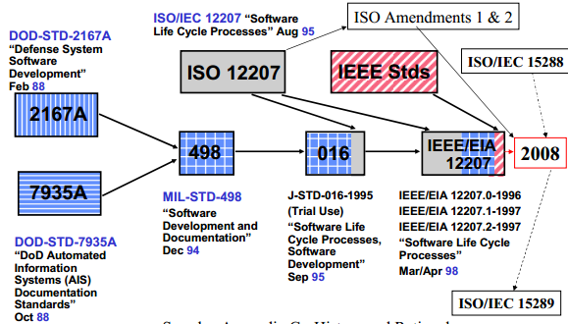
The Software Process (ISO/IEC12207 Perspective) IEEE/IEA 12207 “Standard for Information Technology-Software Life Cycle Processes”
ISO/IEC 12207:1995 (or corresponding IEEE/EIA 12207:1996) establishes a common framework for software life cycle processes
IEEE/IEA 12207: 1996 includes the original ISO/IEC 12207:1995 as well as guidelines for application
defines a comprehensive set of processes that cover the entire life-cycle of a software system
from the time a concept is made to the retirement of the software.
Notes:
defines a comprehensive set of processes that cover the entire life-cycle of a software system — from the time a concept is made to the retirement of the software.

Slide 5
IEEE Std 12207, "Systems and software engineering -- Software life cycle processes", is an international standard that establishes a common framework for software life cycle process, with well-defined terminology.
IEEE Std 12207-2008 is identical to ISO/IEC 12207:2008
This standard defines a comprehensive set of processes that cover the entire life-cycle of a software system—from the time a concept is made to the retirement of the software.
The standard defines a set of processes, which are in turn defined in terms of activities. The activities are broken down into a set of tasks.
The processes are defined in three broad categories: Primary Life Cycle Processes, Supporting Life Cycle Processes, and Organisational Life Cycle Processes.

Slide 6
ISO/IEC12207 Software Life Cycle Processes
Primary
Supporting
Documentation
Acquisition
Configuration Management
Supply
Quality Assurance
Development
Verification
DEVELOPMENT
Validation
Operation
Joint Review
Maintenance
Audit
Problem Resolution
Organizational
Management
Infrastructure
Improvement
Training

Slide 7
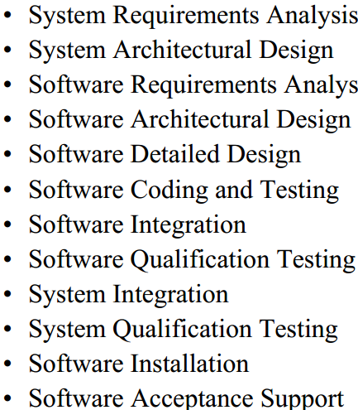
Software Lifecycle Phases (12)

Slide 8
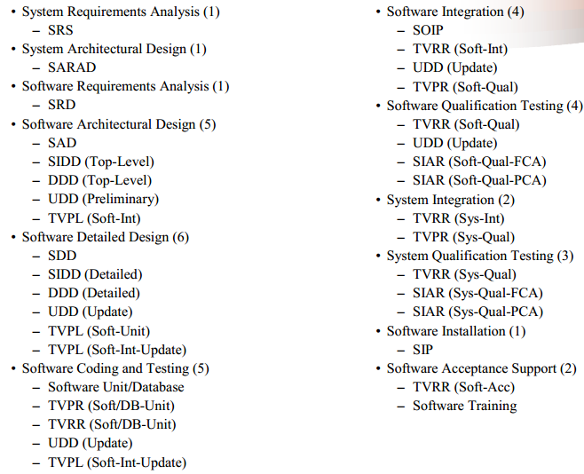
PRODUCTS (35)

Slide 10
The software process
A structured set of activities required to develop a software system.
Many different software processes but all involve:
Specification – defining what the system should do;
Design and implementation – defining the organization of the system and implementing the system;
Validation – checking that it does what the customer wants;
Evolution – changing the system in response to changing customer needs.
These activities come together and form a software development process
Software Development Process is a roadmap. It describes the structure within which software engineers operate

Slide 11
Umbrella Activities
Software requirements management
Software project planning
Software project tracking and oversight
Software quality assurance
Software configuration management
Software subcontract management
Formal technical reviews
Risk management
Measurement – process, project, product
Reusability management (component reuse)
Work product preparation and production

Slide 12
Software Development Process Activities
The steps involved in development of a software product:
Requirements analysis and specification
Design
Implementation
Testing and Integration (Validation)
Maintenance (Evolution)
Each of these steps produce some deliverables:
source code, test data, user manual, requirements specification, design specification, source code, test cases, test plan, executable code
“Software Engineering,” B. W. Boehm,
IEEE Transactions on Computers, vol. 25, no. 12, 1976

Slide 13
Requirements Analysis & Specification
Deliverables: SRS (Software Requirements Specification)
Requirements analysis
client conceptualizes a product
concept exploration by developers
Is the product feasible?
Is it possible to meet the client’s constraints (cost, deadline, size)?

Slide 14
Requirements Analysis & Specification
The main goal is to develop a complete, consistent, unambiguous specification of the requirements
system requirements (includes hardware requirements)
functional requirements for software
Quality requirements
This specification should describe what the software is supposed to do but not how to do it
It is very costly to fix errors in the requirements specification

Slide 15
Requirements Analysis & Specification
Without requirements specification document
How does the designer know what to do, where to start?
How do you test the product?
Client does not have a clear statement about what is being built
It is hard to manage the development process since it is not clear what is being built

Slide 16
Design
Deliverables: Design specification
In the design phase we decide how to do what has been specified in the requirements phase
Design principles:
Modularization: Decide on which modules to implement, what each module does, module interfaces
Abstraction, information hiding
Separation of concerns
Top-down vs. bottom-up
Notes:
Stepwise refinement by functional decomposition

Slide 17
Design
Design techniques:
Object-Oriented design
Design by contract
….
Specification of Object-Oriented designs
Class-Responsibilities-Collaboration (CRC) cards
UML class diagrams
Specification of detailed design
Pseudo code, Program Design Language (PDL)
UML activity diagrams

Slide 18
Implementation
Deliverables: Source code
A good, well-specified design makes the programming easier
First, the code should be correct, i.e., implement the design specification
The code should be maintainable
Good documentation!
Javadoc for Java, docgen for C++: These tools automatically generate API documentation in HTML from special comments in the source code
The code should be traceable
The code should be efficient

Slide 19
Testing and Integration
Deliverables: Test cases, test plan
Goal: check that the product meets the specifications
Testing can be used to show presence of errors not their absence!
Although we mention testing of the implementation as a separate phase each phase of the development (requirements specification, design specification) should be validated
through inspection of the documents produced
or using automated verification techniques if available
there are automated verification tools for various formal specification languages (scalability is a problem)

Slide 20
Testing and Integration
Code inspections (reviews, walk-throughs)
Module testing
testing the functionality of each module or component in isolation
Integration testing
testing the overall system after all the components are combined
Black-box vs. white box testing
Coverage metrics: statement coverage, branch coverage

Slide 21
Maintenance
This phase covers any changes to the product after it has been tested
Costs more than all other phases combined
All the deliverables should be maintained including requirements specification, design specification, test cases
Corrective maintenance
Removal of residual errors in the software
Adaptive maintenance
Adjusting the software to changes in the environment
Perfective maintenance
Changing software to improve some of its qualities

Slide 22
Software Development Process Model
Software development process models
determine the stages (and their order) involved in software development and evolution
establish the transition criteria for progressing from one stage to the next
Answer the questions:
What shall we do next?
How long shall we continue to do it?
A software development process model is an abstract representation of a process. It presents a description of a process from some particular perspective.

Slide 23
What / who / why is Process Models?
What: Go through a series of predictable steps--- a road map that helps you create a timely, high-quality results.
Who: Software engineers and their managers, clients also. People adapt the process to their needs and follow it.
Why: Provides stability, control, and organization to an activity that can if left uncontrolled, become quite chaotic. However, modern software engineering approaches must be agile and demand ONLY those activities, controls and work products that are appropriate.
What Work products: Programs, documents, and data
What are the steps: The process you adopt depends on the software that you are building. One process might be good for aircraft avionic system, while an entirely different process would be used for website creation.
How to ensure right: A number of software process assessment mechanisms that enable us to determine the maturity of the software process. However, the quality, timeliness and long-term viability of the software are the best indicators of the efficacy of the process you use.

Slide 24
Plan-driven and agile processes
Plan-driven processes are processes where all of the process activities are planned in advance and progress is measured against this plan.
In agile processes, planning is incremental and it is easier to change the process to reflect changing customer requirements.
In practice, most practical processes include elements of both plan-driven and agile approaches.
There are no right or wrong software development processes.
critical systems, a very structured development process
business systems, with rapidly changing requirements, a less formal, flexible process

Slide 25
The Waterfall Model (1)
Sometimes called the classic life cycle
Suggests a systematic, sequential (or linear) approach to s/w development
The oldest paradigm for s/w engineering
Plan-driven model. Separate and distinct phases of specification and development.
Works best when –
Requirements of a problem are reasonably well understood
Well-defined adaptations or enhancements to an existing system must be made
Requirements are well-defined and reasonably stable

Slide 26
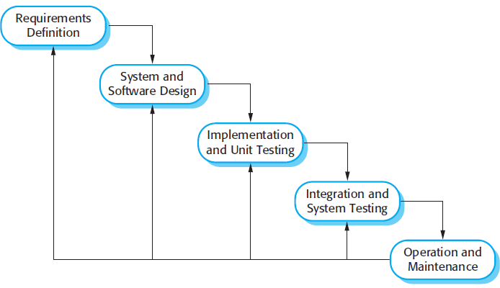
The waterfall model
1970 Royce

Slide 27
The Waterfall Model (2)
Communication
project initiation
requirements gathering
Planning
estimating
scheduling
tracking
Modeling
analysis
design
Construction
code
test
Deployment
delivery
support
feedback
pressman

Slide 28
Waterfall model phases
There are separate identified phases in the waterfall model:
Requirements analysis and definition
System and software design
Implementation and unit testing
Integration and system testing
Operation and maintenance
The main drawback: the difficulty of accommodating change after the process is underway.
A phase has to be complete before moving to the next
the result of each phase is one or more documents that are approved.

Slide 29
Document driven
Waterfall is document driven
Documents: requirements specification, design specification, test-plan
These documents are crucial in achieving maintainability, traceability and visibility
Extended documentation after each phase. Why?
Verbal record is too intangible for management decisions
Written description forces to provide tangible evidence for completion
Prevents “I am 90% complete” syndrome
In early phases, design=documentation and specification=documentation
Permits effective redesign and shared understanding of the project
the process visible so managers can monitor progress against the development plan

Slide 30
The Waterfall Model - Problems
Real projects rarely follow the sequential flow
Accommodates iteration indirectly
Changes can cause confusion
It is often difficult for the customer to state all requirements explicitly
Has difficulty accommodating the natural uncertainty that exists at the beginning of many projects

Slide 31
More problems
A working model of the software is not available until late in the project life-span
an undetected mistake can be very costly to fix
the delivered program may not meet the customer’s needs
the requirements have to be stated completely before the implementation starts. It is often difficult for the customer to state all requirements explicitly
Redoing the whole phase is an enormous piece of work
Influence from other phases or events are not considered.
For example: Errors found in test stage might be influenced from; Effect of new hires, Frustration among group members.

Slide 32
workarounds
Involve customers before final delivery= Reviews
Reviews. Review the documents with the customer
There are 9 reviews in IEEE 12207
What if the product is totally original? Some experimentation is required before building the system
Prototypes!
Build it twice to test some key hypothesis
Beware, prototypes are dirty. Do not bring them into real production. Throw them out.
Use them to identify requirements
Test your hypothesis
Interact with customer to clarify things

Slide 33
After Prototyping
Software
Requirements
Design
Implementation
Design
Implementation
Testing
Testing
Operations &
Maintenance
Operations
Build once to get feedback. Build the second to deliver

Slide 34
Rapid Prototyping – Throwaway prototypes
Especially useful for interactive applications
After an initial requirements analysis, a quick design is developed
This quick design should focus on aspects of the software that will be visible to the user such as input/output formats
The quick design is used to construct a prototype
The prototype is reviewed by the customer and/or user to refine the requirements for the software to be developed
Prototype serves as a mechanism for identifying software requirements

Slide 35
Rapid Prototyping
Dangers of prototyping
The quick and possibly poor choices made in the design and the implementation of the prototype may influence the real product
After seeing a prototype customer may demand a working product fast
The prototype becomes the requirements specification. Since requirements specification serves as a contract between customer and developer, a prototype may not be a good contract

Slide 36
Waterfall: all parts seems to integrate well but we have a number of problems in real life
Software development is not sequential, need feedback from other phases
Use waterfall only if requirements are stable
Well understood and unlikely to change radically
Since waterfall is consistent with other engineering processes, it is still used
Several variants of waterfall
Overlapping phases in practice

Slide 37
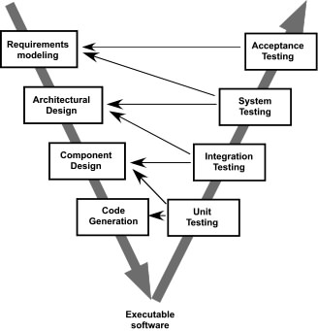
The V-Model
A variation of waterfall model depicts the relationship of quality assurance actions to the actions associated with communication, modeling and early code construction activates.
Team first moves down the left side of the V to refine the problem requirements. Once code is generated, the team moves up the right side of the V, performing a series of tests that validate each of the models created as the team moved down the left side.

Slide 38
Incremental
Rather than deliver the system as a single delivery, the development and delivery is broken down into increments with each increment delivering part of the required functionality.
User requirements are prioritised and the highest priority requirements are included in early increments.
Once the development of an increment is started, the requirements are frozen though requirements for later increments can continue to evolve.

Slide 39
Incremental Process Models
Analysis
Design
Code
Test
Increment #1
Increment #1
Analysis
Design
Code
Test
Increment #2
Increment #2
Analysis
Design
Code
Test
Increment #3
Increment #3
Functionality grow with increments

Slide 40
Incremental Process Models
Combines elements of the waterfall model applied in an iterative fashion
Each linear sequence produces deliverable “increments” of the software
The first increment is often a core product
The core product is used by the customer (or undergoes detailed evaluation)
Based on evaluation results, a plan is developed for the next increment

Slide 41
When initial requirements are reasonably well defined, but the overall scope of the development effort precludes a purely linear process.
A compelling need to expand a limited set of new functions to a later system release.

Slide 42
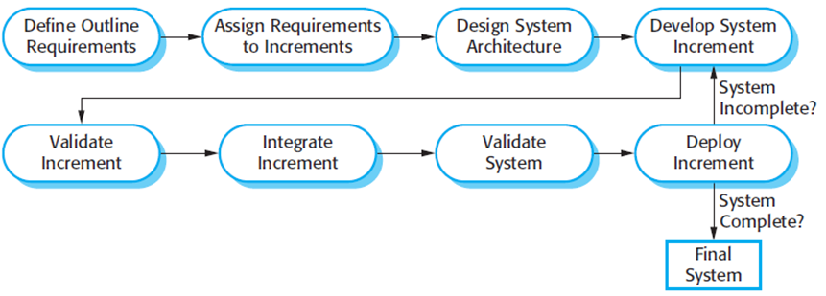
Incremental

Slide 43
It avoids the premature commitment to requirements for the whole system and allows changes to be incorporated into later increments at relatively low cost.
In each iteration there is a place for requirement analysis for later increments (but requirement in current increment is frozen)
There is no complete specification until the final increment is specified

Slide 44
advantages
Customer value can be delivered with each increment so system functionality is available earlier.
Most important requirements satisfied without waiting for the delivery of entire system
Early increments help elicit requirements for later increments.
Lower risk of overall project failure.
The highest priority system services tend to receive the most testing.
less likely to encounter software failures in the most important parts of the system.

Slide 45
problems
Most systems require a set of basic facilities that are used by different parts of the system.
As requirements are not defined in detail until an increment is to be implemented, it can be hard to identify common facilities that are needed by all increments.
The essence of iterative processes is that the specification is developed in conjunction with the software.
However, this conflicts with the procurement model of many organizations, where the complete system specification is part of the system development contract.
Notes:
There are some types of system where incremental development and delivery is not the best approach. These are very large systems where development may involve teams working in different locations, some embedded systems where the software depends on hardware development and some critical systems where all the requirements must be analyzed to check for interactions that may compromise the safety or security of the system

Slide 46
Evolutionary Process Models
Software, like all complex systems, evolves over a period of time
Business and product requirements often change as development proceeds, making a straight-line path to an end product is unrealistic
However, a limited version must be delivered to meet competitive pressure.

Slide 47
Evolutionary Models
Usually a set of core product or system requirements is well understood, but the details and extension have yet to be defined.
You need a process model that has been explicitly designed to accommodate a product that evolved over time.
It is iterative that enables you to develop increasingly more complete version of the software.

Slide 48
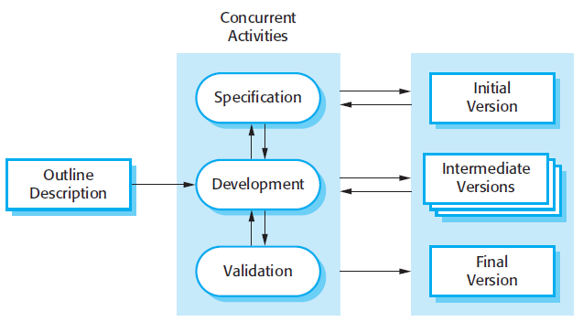
Evolutionary
-developing an initial implementation,
-exposing this to user comment
-evolving it through several versions until an adequate system has been developed
Notes:
Book says incremental model but most communities say incremental model to what the book says incremental delivery.
This model is evolitionary model

Slide 49
Evolutionary Prototyping
When to use: Customer defines a set of general objectives but does not identify detailed requirements for functions and features. Or Developer may be unsure of the efficiency of an algorithm, the form that human computer interaction should take.
What step: Begins with communication by meeting with stakeholders to define the objective, identify whatever requirements are known, outline areas where further definition is mandatory. A quick plan for prototyping and modeling (quick design) occur. Quick design focuses on a representation of those aspects the software that will be visible to end users. ( interface and output). Design leads to the construction of a prototype which will be deployed and evaluated. Stakeholder’s comments will be used to refine requirements.
Both stakeholders and software engineers like the prototyping paradigm. Users get a feel for the actual system, and developers get to build something immediately. However, engineers may make compromises in order to get a prototype working quickly. The less-than-ideal choice may be adopted forever after you get used to it.

Slide 50
Problems
Customers may press for immediate delivery of working but inefficient products
The developer often makes implementation compromises in order to get a prototype working quickly

Slide 51
Output Progression
Waterfall
Evolutionary
Incremental
time

Slide 52
Risk?
Risk: Situations or possible events that can cause a project to fail to meet its goals
Risk is related to the amount and quality of available information.
The less information, the higher the risk
High-risk activities cause schedule and cost overruns
A risk management plan enumerates the risks and prioritizes them in degree of importance, as measured by a combination of the impact and likelihood of each

Slide 53
Hybrid Process Models
Large systems are usually made up of several sub-systems
The same process model need not be used for all subsystems
Evolutionary development for high-risk specifications
Waterfall model for well-understood specifications

Slide 54
Boehm’s spiral model
Process is represented as a spiral rather than as a sequence of activities with backtracking.
Each loop in the spiral represents a phase in the process.
No fixed phases such as specification or design - loops in the spiral are chosen depending on what is required.
Risks are explicitly assessed and resolved throughout the process.
Risk: sth that can go wrong
Highlight : RISK driven!

Slide 55
Spiral Model
cumulative cost
progress in
each cycle
Determine objectives,
alternatives, constraints
Evaluate alternatives,
identify, resolve risks
start
Develop, verify
next-level product
Plan next phase
radial dimension shows the cumulative cost
angular dimension shows the progress in each cycle

Slide 56
Spiral Model
Spiral model consists of iterative cycles
Spiral model is a hybrid process model
Each cycle consists of four phases (steps):
Step 1: Objective setting
Identify the objectives (for example: performance, functionality, ability to accommodate change)
Identify the alternative means of implementing this portion of the product (for example: different designs, reuse, buy)
Identify the constraints imposed on the application of the alternatives (for example: cost, schedule)

Slide 57
Spiral Model Phases
Step 2: Risk assessment and reduction
Evaluate the alternatives relative to objectives and constraints.
Evaluate the risks involved with each alternative
Resolve the risks using prototyping, simulation, benchmarking, requirements analysis, etc.
Example
alternative: write a requirements specification
risk: customer may not be able to articulate the requirements precisely which may end up a costly redevelopment effort
risk resolution: develop a rapid prototype

Slide 58
Spiral Model Phases
Step 3: Develop and validate
Develop and verify the product
Product could be the software requirements specification, the design specification, etc.
Step 4: Planning
Review the project
Plan the next phase
Depending on the next-phase this could be a requirements plan, an integration and test plan, etc.

Slide 59
Spiral Model – An example

Slide 60
Spiral Model
The basic idea in spiral model is to evaluate and resolve risks at every step of the development
Based on the risks involved in the development spiral model may become equivalent to other models (or a mixture of them)
E.g., If a project
has a low risk in user-interface and performance requirements and
has a high risk in budget and schedule predictability and control,
based on these risks spiral model may turn into the waterfall model

Slide 61
The Spiral Model
Unlike other process models that end when software is delivered, the spiral model can be adapted to apply throughout the life of the software
The circuits around the spiral might represent
Concept development project
New Product development project
Product enhancement project
The spiral model demands a direct consideration of technical risks at all stages of the project

Slide 62
Difficulties
Do not match to contract software
Assumes software will be developed internally
Contract software might not provide flexibility of step by step commitments
Rely on subjective risk assessment expertise
Concentrating on high risk elements might require correct identification of high risk elements in advance

Slide 63
Other Process Models
Component based development—the process to apply when reuse is a development objective
Formal methods—emphasizes the mathematical specification of requirements ( easy to discover and eliminate ambiguity, incompleteness and inconsistency)
Aspect Oriented software development (AOSD)—provides a process and methodological approach for defining, specifying, designing, and constructing aspects
Unified Process—a “use-case driven, architecture-centric, iterative and incremental” software process closely aligned with the Unified Modeling Language (UML) to model and develop object-oriented system iteratively and incrementally.

Slide 64
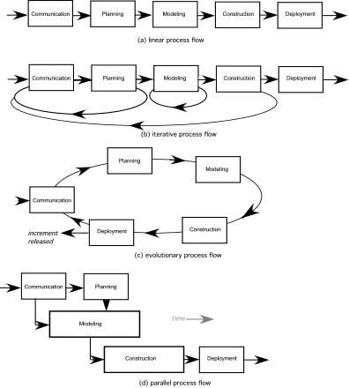
Process Flow

Slide 65
Process Flow
Linear process flow executes each of the five activities in sequence.
An iterative process flow repeats one or more of the activities before proceeding to the next.
An evolutionary process flow executes the activities in a circular manner. Each circuit leads to a more complete version of the software.
A parallel process flow executes one or more activities in parallel with other activities ( modeling for one aspect of the software in parallel with construction of another aspect of the software.

